Slide 1
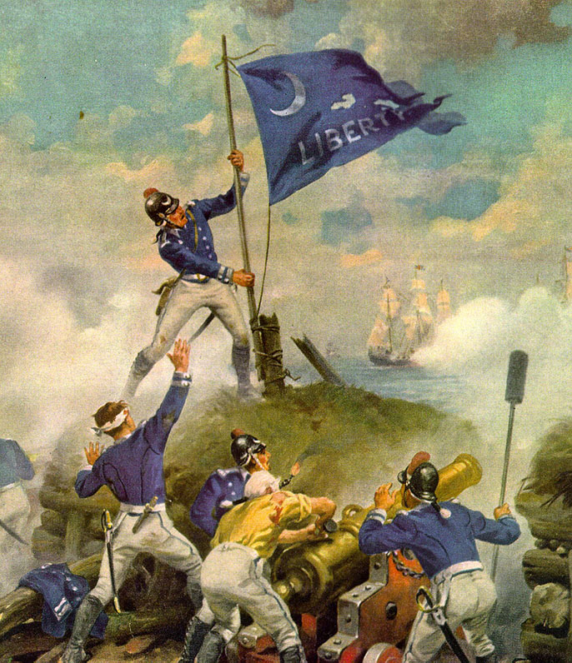
Carolina Day aka… The Battle of Sullivan’s Island
By George thurmond

Slide 2
Preparing for Battle
British sail for Cape Fear, NC in January 1776
Governor Rutledge organizes a defense force in Charleston
1st Regiment of South Carolina commanded by Col Christopher Gadsden of
Gadsden flag fame – to defend mainland Charleston
2nd Regiment under command of Col William Moultrie to prepare defense
on Sullivan’s Island – to protect the entrance to Charleston
Construction of defenses started in March 1776 using palmetto logs 16 feet long, covered with sand.

Slide 3
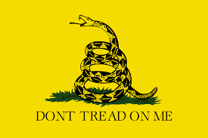
Col. Christopher Gadsden and the Gadsden Flag

Slide 4
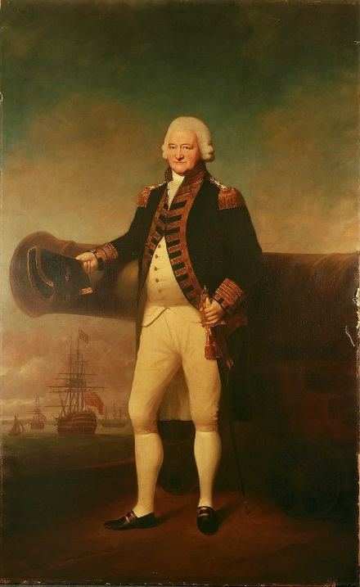
June 1st
26 cannon were installed in gun platforms in the 500 feet long wall- 10 feet
high – 1,125 troops
British under command of Sir Peter Parker (Admiral) / Gen Henry Clinton
(2,900 troops)
Order of Battle: 9 Man of War as well as ships of the line (7) =300 heavy cannon
Battle Plan: Clinton to land troops on Long Island nearby and attack from the rear
with 16 ships firing on Sullivan’s Island
Sir Peter Parker

Slide 5
June 2nd
General Charles Lee, commander of the Southern Department disapproved the construction
but was overruled by Governor Rutledge.
Work on the construction was speeded up but the rear wall was incomplete
and would be easy to capture if attacked from the rear.
Col William Thomson defended the extremity of Long Island where Clinton was expected to land.

Slide 6
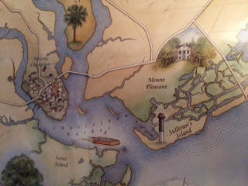
June 26th
British were ready

Slide 7
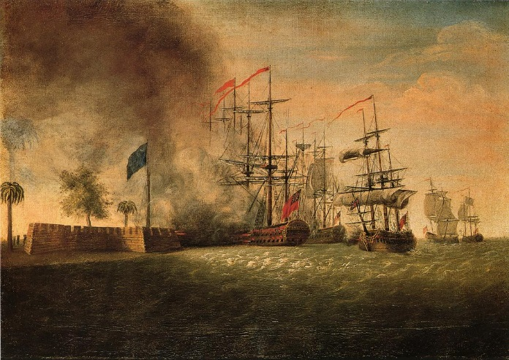
June 27th
British learn that the shallowest channel was 7 feet deep and were met with gunfire from Col Thomson’s gunners. - There will be no landing!

Slide 8
June 28th
The Patriots had only 28 rounds for their 26 guns and limited gun powder
The tide literally turned against the British as the Pilots refused to bring the ships with their gunners as close as ordered in fear of running aground. When the tide turned three of the ships ran aground
In the meantime, inexperienced gunners were pouring deadly fire into the British Fleet with terrible effect. Every person on the quarter deck of the flagship was killed or wounded, including Sir Peter Parker who had his pants tore off by a splinter.
British continued to bombard the fort with little effect as the soft, spongy palmetto logs absorbed the cannonballs

Slide 9
June 28th

Slide 10
June 28th

Slide 11
June 28th
At this point, a cannon ball took down the Moultrie flag flying whereupon, Sgt William Jasper asked his commander, “Sir would you have us fight without a flag”? He then vaulted over the top of the parapet to recover the flag, remounted it on a wooden cannon swabbing pole. He then stood before the British cannons waving the flag in defiance of the attack. Jasper mounted the flag where it remained for the rest of the battle.
Following the battle, he was presented with Governor Rutledge’s ceremonial gold sword and offered a commission which he declined. His untimely death at the battle of Savannah ended his heroism and forever etched his bravery in our memory. He is remembered by a statue in Madison Square in Savannah. Had he lived, he would have been compared to Sgt York of WWI fame.

Slide 12
Sgt. William Jasper

Slide 13
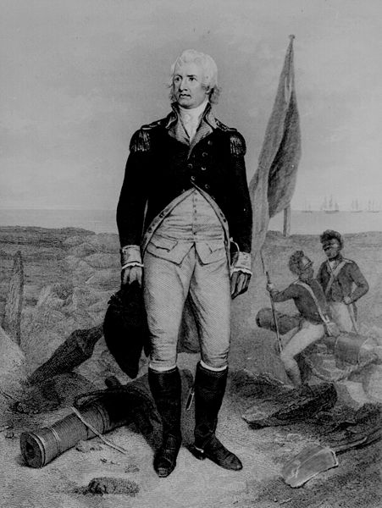
Col. William Moultrie and The Moultrie Flag

Slide 14
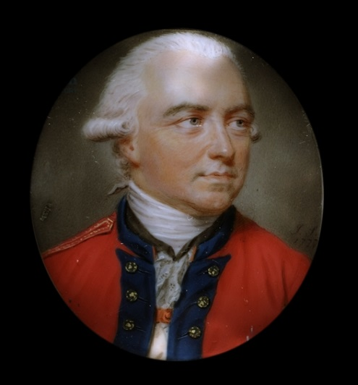
June 28th
A second attempt by Gen Clinton resulted in heavy casualties when fired upon at point blank range. Clinton called off the attack at 9:30 with the British withdrawing at 11:30 hours.
General Henry Clinton
3 British ships ran aground, with HMS Acteon requesting permission to abandon ship and destroy the ship, commissioned only the year before. Patriots boarded when set ablaze and salvaged the ships bell, colors and stores. Half an hour later the ship’s magazine exploded.

Slide 15
After the Battle of Sullivan’s Island
The British did not attempt to renew the battle and withdrew to participate in the New York campaign.
Final Result: Patriots 17 killed, 20 wounded / British 64 killed, 131 wounded and one ship lost.
Each year June 28 is celebrated in Charleston as “Carolina Day”.
Now for the rest of the story. Following the battle, Congress converted the 1st and 2nd South Carolina
Regiments into the Continental Line, promoted Colonels Gadsden and Moultrie to Brigadier General.
Charleston would remain out of danger from the war for almost the next four years.

